Slide 1
A Mini Project Report on
PHYSICS [PH 101]
Submitted in partial fulfilment of the requirement for the Degree of
B. Tech.
in
Computer Science and Technology
Submitted By:
Rahul Gautam Singh : 1912082
Ashish Upadhyaya : 1912132
Prottay Kumar Adhikary : 1912157
Saurabh Sinha : 1912159
Subhojit Ghimire : 1912160
Under the guidance of:
Dr. P. Srinivasan
Assistant Professor, Grade I
Department of Physics
NIT Silchar

Slide 2
Wavefunction
Wave function is a variable quantity that mathematically describes the wave characteristics of a particle.
It is a function describing the probability of a particle’s quantum state as a function of position, momentum, time, and/or spin.
It is denoted by the Greek Symbol ψ (pronounced as ‘psi’)

Slide 3
Properties of Wavefunction
All the measurable information about the particle is available.
Ψ should be continuous and single-valued.
Probability distribution in three dimensions is established using the wave function.
The probability of finding a particle, if it exists, is 1.
Using Schrodinger Equation, energy calculations become easy to solve.

Slide 4
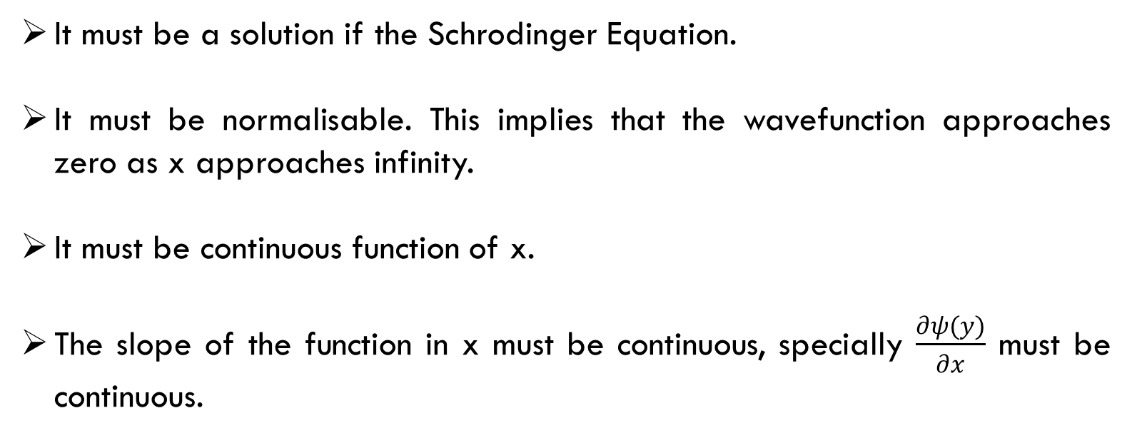
Constraints of Wavefunction
It must be a solution if the Schrodinger Equation.
It must be normalisable. This implies that the wavefunction approaches zero as x approaches infinity.
It must be continuous function of x.
The slope of the function in x must be continuous, specially $\frac{∂ψ(y)}{∂x}$ must be continuous.

Slide 5
Postulates of Quantum Mechanics
With the help of time-dependent Schrodinger equation, the time evolution of wave function is given.
For a particle in a conservative field of force system, using wave function, it becomes easy to understand the system.
Linear set of independent functions is formed from the set of eigen functions of operator Q.
Operator Q associated with a physically measurable property q is Hermitian.
By performing the expectation value integral with respect to the wave function associated with the system, the expectation value of the property q can be determined.
For every physical observable q, there is an operator Q operating on wave function associated with a definite value of that observable such that it yields wave function of that many times.

Slide 6
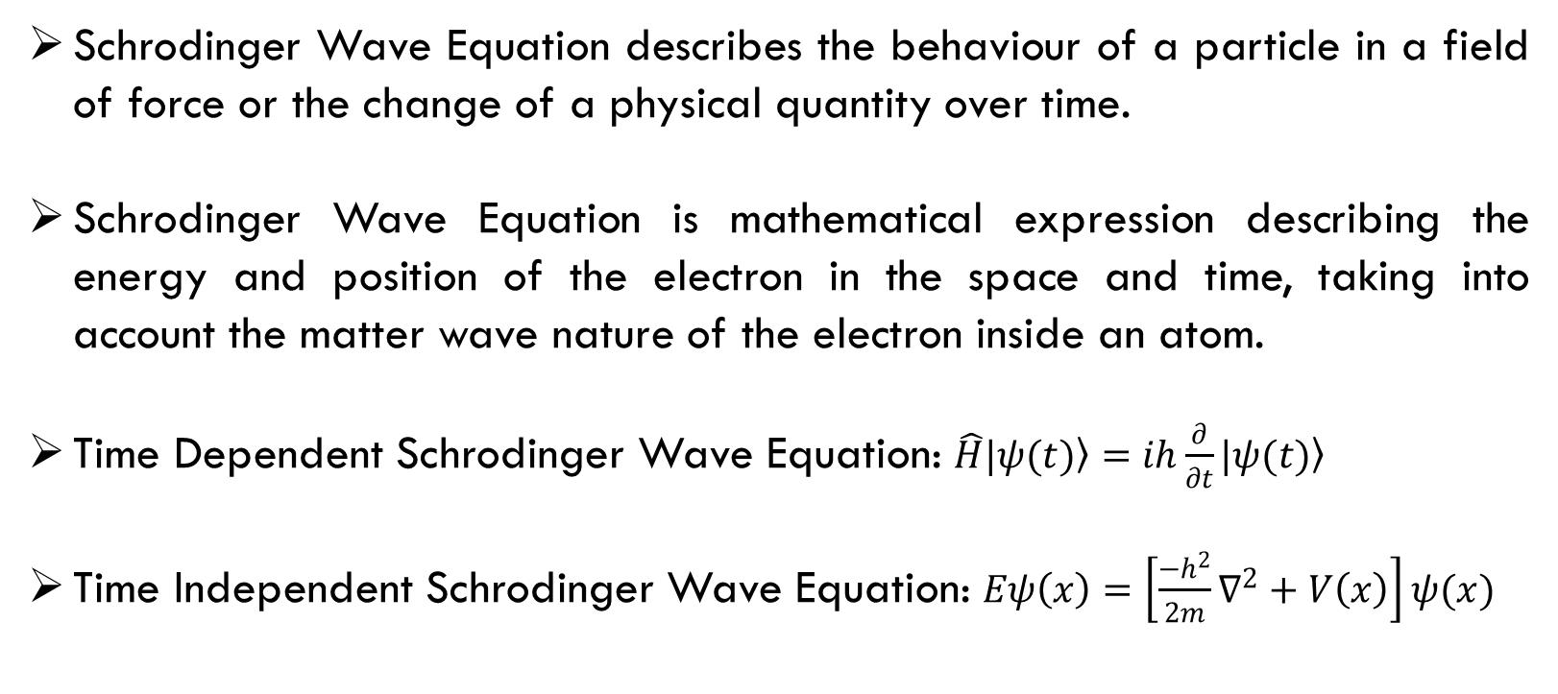
Schrodinger Wave Equation
Schrodinger Wave Equation describes the behaviour of a particle in a field of force or the change of a physical quantity over time.
Schrodinger Wave Equation is mathematical expression describing the energy and position of the electron in the space and time, taking into account the matter wave nature of the electron inside an atom.
Time Dependent Schrodinger Wave Equation: $\hat{H}\left.|ψ(t)\right\rangle =ih\frac{∂}{∂t}\left.|ψ(t)\right\rangle$
Time Independent Schrodinger Wave Equation: $Eψ\left(x\right)=\left[\frac{−h^{2}}{2m}∇^{2}+V\left(x\right)\right]ψ(x)$

Slide 7
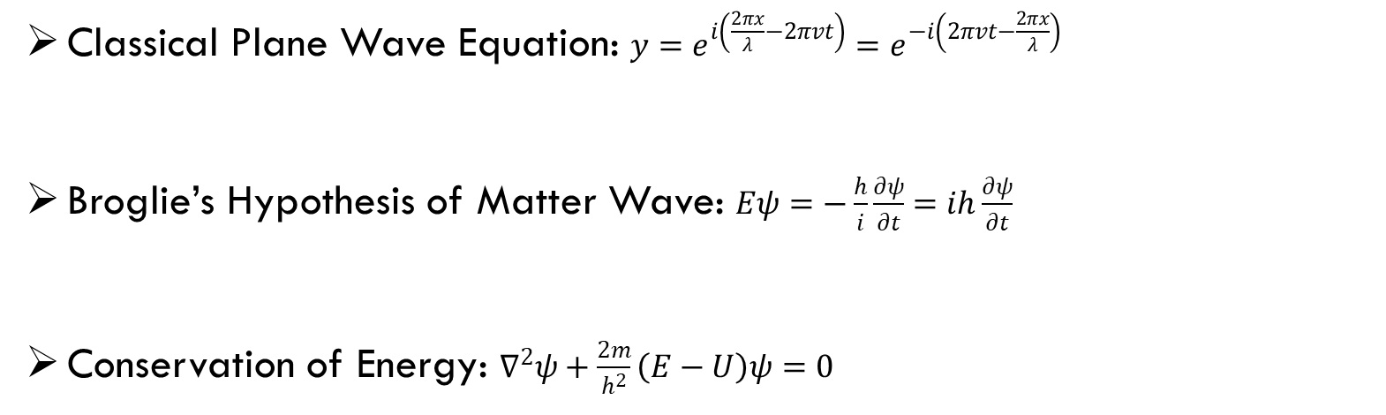
Schrodinger Wave Equation Considerations
Classical Plane Wave Equation: $y=e^{i\left(\frac{2πx}{λ}−2πvt\right)}=e^{−i\left(2πvt−\frac{2πx}{λ}\right)}$
Broglie’s Hypothesis of Matter Wave: $Eψ=−\frac{h}{i}\frac{∂ψ}{∂t}=ih\frac{∂ψ}{∂t}$
Conservation of Energy: $∇^{2}ψ+\frac{2m}{h^{2}}\left(E−U\right)ψ=0$

Slide 8
Physical Significance of Schrodinger Wave Function
Bohr concept of an atom cannot explain the presence of multiple orbitals and the fine spectrum arising out of them. It is applicable only to the one-electron system.
Schrodinger wave function has multiple unique solutions representing characteristic radius, energy, amplitude.
Schrodinger equation could explain the presence of multiple orbitals and the fine spectrum arising out of all atoms, not necessarily hydrogen-like atoms.

Slide 9
Thank You

